Slide 4
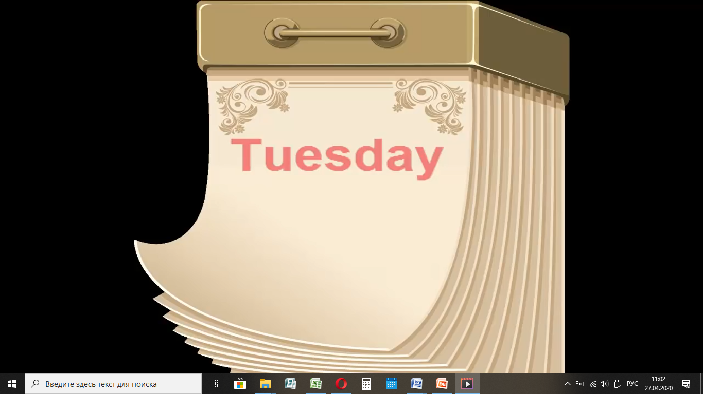

Slide 5
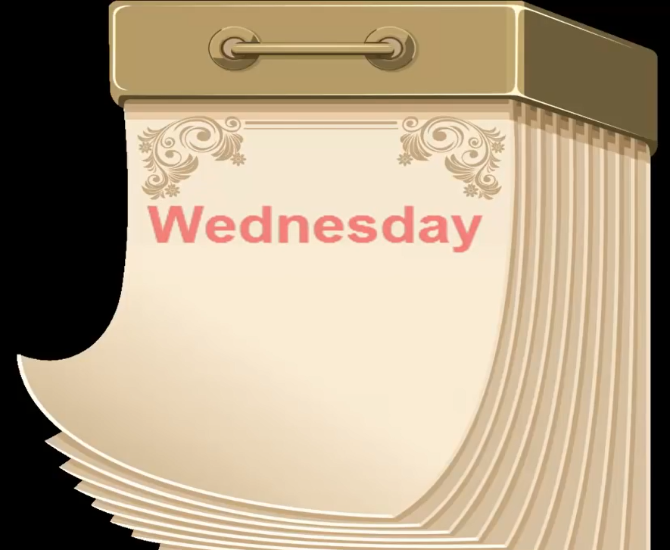

Slide 6
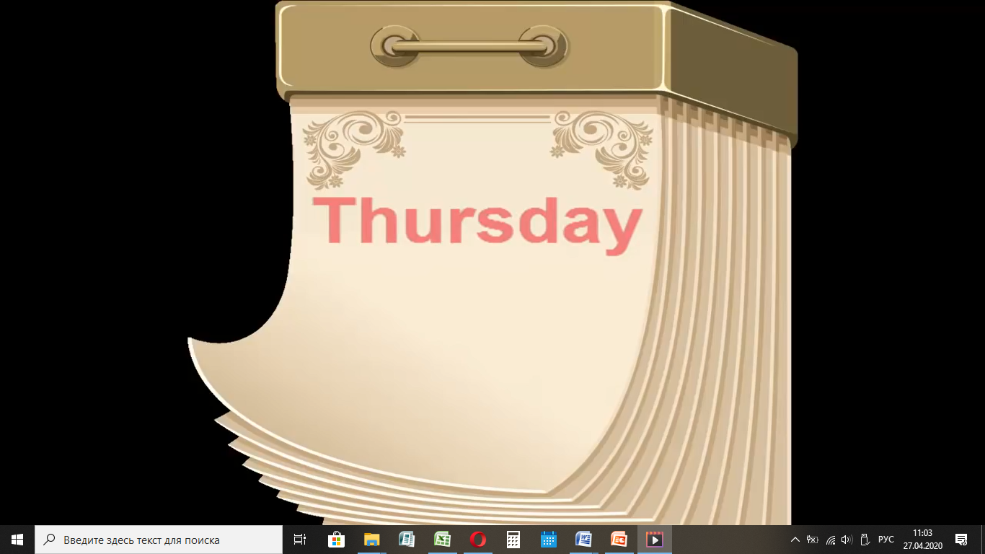

Slide 7
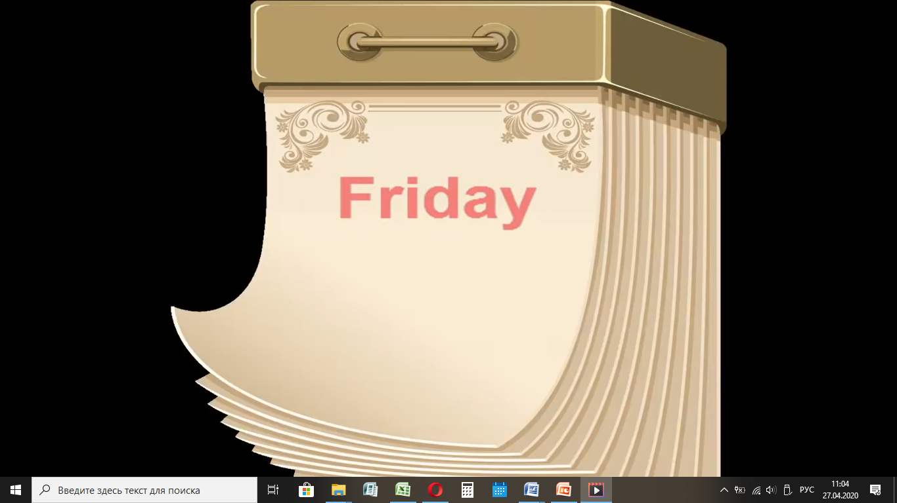

Slide 9
What day is it today? –Какой сегодня день недели?
It’s Monday – понедельник
It’s Tuesday – вторник
It’s Wednesday - среда
It’s Thursday - четверг
It’s Friday – пятница
It’s Saturday - суббота
It’s Sunday - воскресенье

Slide 10
«The Present Simple Tense» Настоящее проcтое время.
Это время обозначает действие, которое происходит регулярно - всегда, обычно, постоянно, каждый день(год, неделю, месяц), часто, никогда, иногда и т.д.
(+, -, ?)
^{Указатели времени}
(сигналы) : every day/week/usually/often/

Slide 11
Утвердительная форма +.
watch TV
(Present Simple – Настоящее простое время)
I watch TV every day.
You watch TV every day.
He/She/It watches TV every day.
We watch TV every day.
They watch TV every day.

Slide 12
Отрицательная форма -.
I do not (don’t)watch TV every day.
You do not (don’t)watch TV every day. He/She/It watches TV every day.
He/She/It does not (doesn’t)
watch TV every day.
We do not (don’t)watch TV every day.
They do not (don’t)watch TV every day.

Slide 13
Вопросительная форма ?
I watch TV every day.
Do I watch TV every day?
You watch TV every day.
Do you watch TV every day?
He/She/It watches TV every day.
Does he/she/it watch TV every day?
We watch TV every day.
Do we watch TV every day?
They watch TV every day.
Do they watch TV every day?

Slide 14
Правописание глаголов в
3 лице ед.ч.
+ -s
I paint – he paints
We read – she reads
ss,-sh,-ch,-x,-o + - es
I watch TV – he watches TV
Согласная + y
y - i и добавляется –es
I study – he studies
BUT
I play – he plays

